Slide 1
Subtyping and Inheritance
Dirk Riehle, FAU Erlangen
ADAP B03
Licensed under CC BY 4.0 International

Slide 2
Agenda
What is subtyping?
Liskov substitutability principle
Applied to class hierarchies
Co- and contravariance
Multiple inheritance
Abstract superclass rule
Cascading class hierarchies
Homework

Slide 3
1. What is Subtyping?

Slide 4
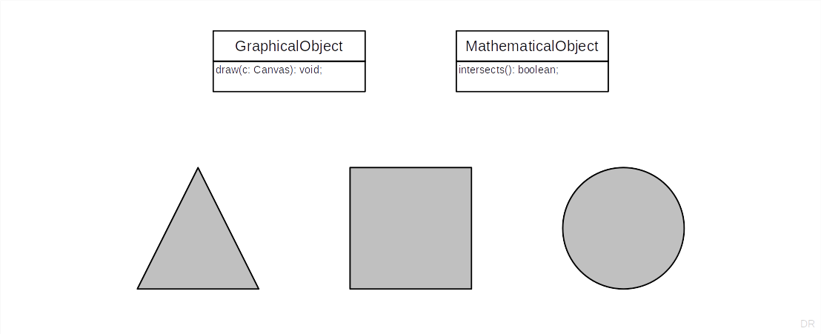
Subtyping Example 1 / 3

Slide 5
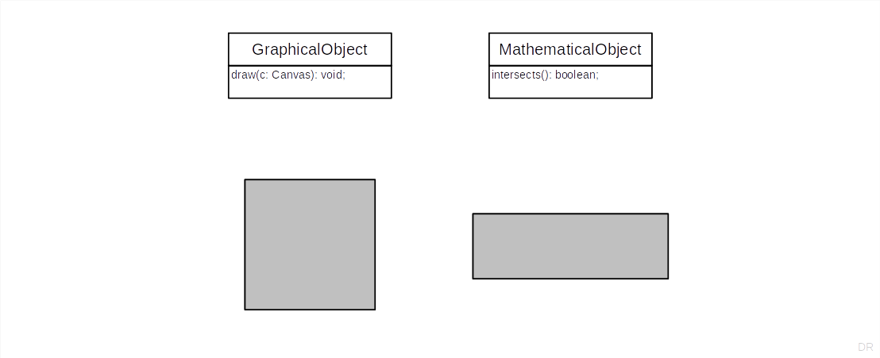
Subtyping Example 2 / 3

Slide 6
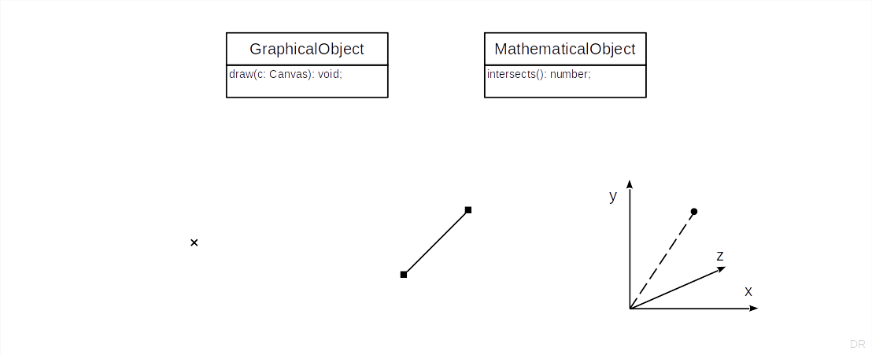
Subtyping Example 3 / 3

Slide 7
2. Liskov Substitutability Principle

Slide 8
The Subtype Requirement [1]
Let φ(x) be a property provable about objects x of type T. Then φ(y) should be provable for objects y of type S, where S is a subtype of T.
[1] A.k.a. the Liskov Substitutability Principle (LSP) [LW94]

Slide 9
In Simpler Words
All properties that hold for instances of a supertype should also hold for instances of a subtype [DR]

Slide 10
Even Simpler
Don’t surprise use-clients

Slide 11
Quiz: What’s the Surprise?
If you make Rectangle a subtype of Square?
If you make Square a subtype of Rectangle?
If you make 2DLine a subtype of Point?
If you make Point a subtype of 2DLine?

Slide 12
3. Applied to Class Hierarchies

Slide 13
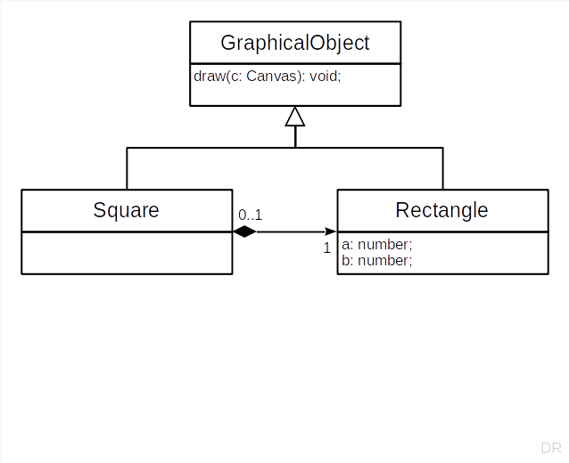
Subclasses as Extended Subtypes
Subclasses
Add methods and state
Do not constraint superclasses

Slide 14
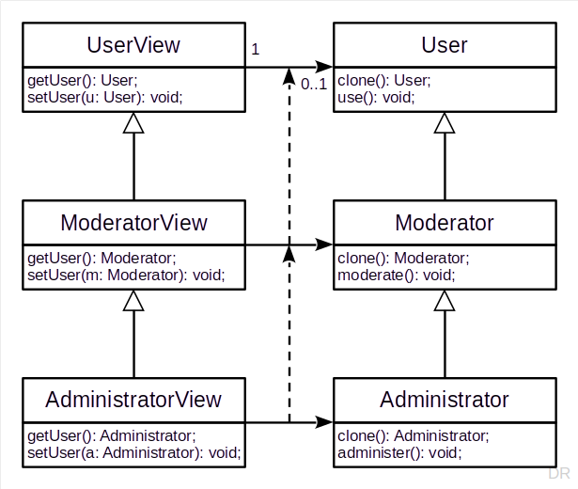
Subclasses as Constrained Subtypes
Subclasses
Constrain behavior in defined space
In method signatures
Using covariant redefinition
Leads to parallel class hierarchies

Slide 15
Extract Superclass Refactoring
A refactoring is a
Behavior-preserving transformation of existing code
The goal is to improve readability, remove redundancy, etc.
The extraction of an abstract superclass is a common refactoring
Fowler’s catalog [1] lists Extract Superclass (without “Abstract” though)
[1] Martin Fowler. Refactoring (2nd Edition). Addison Wesley, 2018.

Slide 16
4. Co- and Contravariance

Slide 17
Covariant Redefinition of Return Types
A return type has been covariantly redefined in a method definition, if
The return type of the subtype’s method is a subtype of the supertype’s
Example of covariant redefinition of return type
UserView.getUser(): User → ModeratorView.getUser(): Moderator
The subtype’s method “returns less” than what the supertype’s method promises
Does not violate the LSP (is within expectations)

Slide 18
Contravariant Redefinition of Return Types
A return type has been contravariantly redefined in a method definition, if
The return type of the subtype’s method is a supertype of the supertype’s
Example of contrvariant redefinition of return type
ModeratorView.getUser(): Moderator → AdministratorView.getUser(): User
The subtype’s method “returns more” than what the supertype’s method promises
Violate the LSP, because clients of the supertype’s methods might be surprised

Slide 19
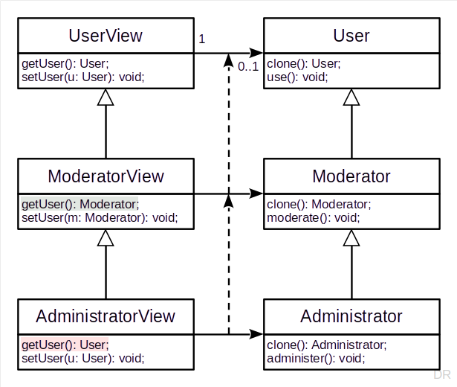
Users / Views Example 1 / 2
let modView1: ModeratorView =
new ModeratorView(new Moderator());
let modAsUserView1: UserView =
modView1 as UserView;
let mod1: Moderator =
modAsUserView1.getUser() as Moderator;
mod1.moderate(); // should work, no problem
let adminView: AdministratorView =
new AdministratorView();
let adminViewAsModView1: ModeratorView =
adminView as ModeratorView;
let mod3: Moderator =
adminViewAsModView1.getUser();
mod3.moderate() // will fail because mod3 is of dynamic type User

Slide 20
Covariant Redefinition of Argument Types
An argument type has been covariantly redefined in a method definition, if
The argument type of subtype’s method is a subtype of the supertype’s
Example of covariant redefinition of argument type
User.setUser(u: User): void → Moderator.setUser(m: Moderator): void
The subtype’s method “accepts less” than what the supertype’s method promises
This violates the LSP and only makes sense if you think in relationships

Slide 21
Contravariant Redefinition of Argument Types
An argument type has been contravariantly redefined in a method definition, if
The argument type of the subtype’s method is a supertype of the supertype’s
Example of contravariant redefinition of argument type
ModeratorView.getUser(): Moderator → AdministratorView.getUser(): User
The subtype’s method “accepts more” than what the supertype’s method promises
Does not violate the LSP but also makes little sense in practice

Slide 22
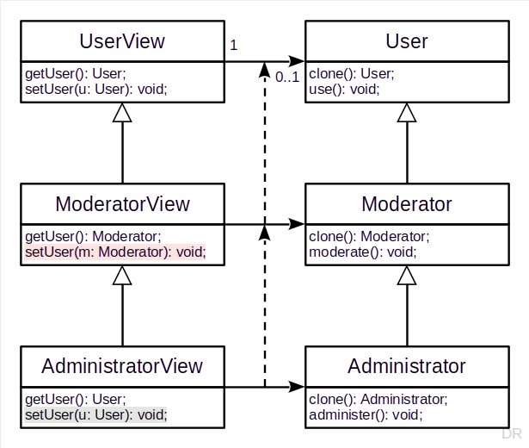
Users / Views Argument Type Example
let modView2: ModeratorView =
new ModeratorView(new Moderator());
let modAsUserView2 =
modView2 as UserView;
modAsUserView2.setUser(new User()); // setup
let mod2: Moderator =
modView2.getUser(); // creates failure point
mod2.moderate(); // should fail
adminView.setUser(new User());
let user1: User = adminView.getUser();
user1.use(); // no problem
let admin1: Administrator = user1 as Administrator;
admin1.administer(); // will fail but also was not promised

Slide 23
Co- and Contravariance in Typescript
 | Covariant Redefinition | Contravariant Redefinition
Return type | is allowed | is not allowed
Argument type | is allowed [2] should not be allowed [1] | is allowed
[1] Should not be allowed because it violates the LSP
[2] Only makes sense if class (role type) is part of a collaboration

Slide 24
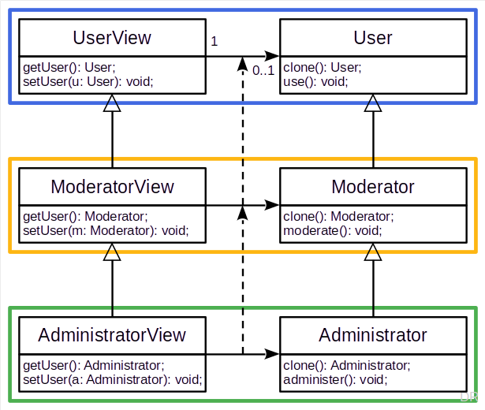
Parallel Class Hierarchies
Parallel class hierarchies are
Two related class hierarchies, subclassed in parallel
Often using covariant redefinition of both return and argument types
The design focus is on the collaboration

Slide 25
5. Multiple Inheritance

Slide 26
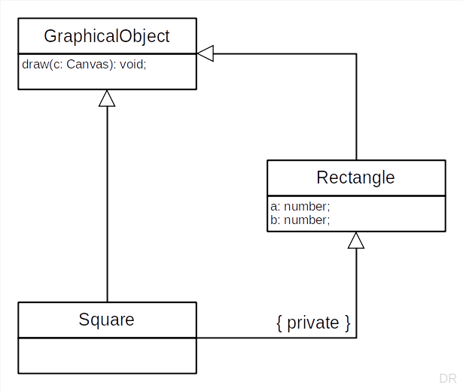
Multiple Inheritance
Multiple inheritance is when
A class has 2+ superclasses
Does not necessarily imply substitutability
Cf. C++’s private inheritance
Not a Typescript feature

Slide 27
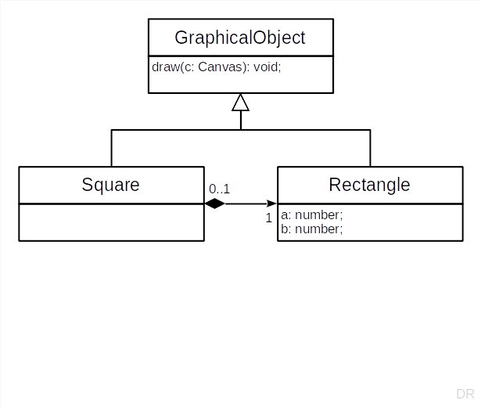
Implementation Delegation
Implementation delegation is when
A class delegates its implementation
Generally better than multiple inheritance
Choose delegation over inheritance

Slide 28
Composition over Inheritance
The composition over inheritance principle states that
You should favor object composition over class inheritance
A.k.a. delegation over inheritance (principle)

Slide 29
6. Abstract Superclass Rule

Slide 30
Inheritance vs. Abstractness
Inheritance is
A relationship between two classes
Abstractness / concreteness
A relationship between a class and its instances

Slide 31
Abstract Superclass Rule (ASR)
All superclasses must be abstract
Corollary: Never subclass a concrete class

Slide 32
ASR in Framework vs. Application
In a framework
Leaf classes may be abstract (awaiting subclassing)
Leaf classes may be concrete (if ready to use)
In an application (based on a framework)
Framework leaf classes may be abstract if unused
Application leaf classes must be concrete

Slide 33
ASR and LSP
The ASR helps to comply with the LSP
The ASR automatically casts subclasses as constrained subtypes

Slide 34
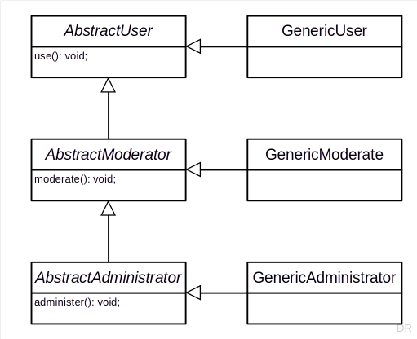
Pragmatics of ASR
Logically separate abstract class from generic implementation subclass
Pragmatically, merge implementation class into abstract class
Make abstract class concrete but maintain inheritance interface

Slide 35
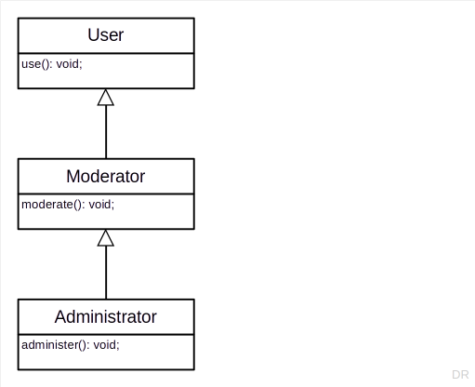
Class Hierarchy Evolution

Slide 36
7. Cascading Class Hierarchies

Slide 37
Before and After Methods
Before and after methods wrap a method’s main body
They typically come in pairs and are about a meta issue
The before method sets something up
The after method tears it down

Slide 38
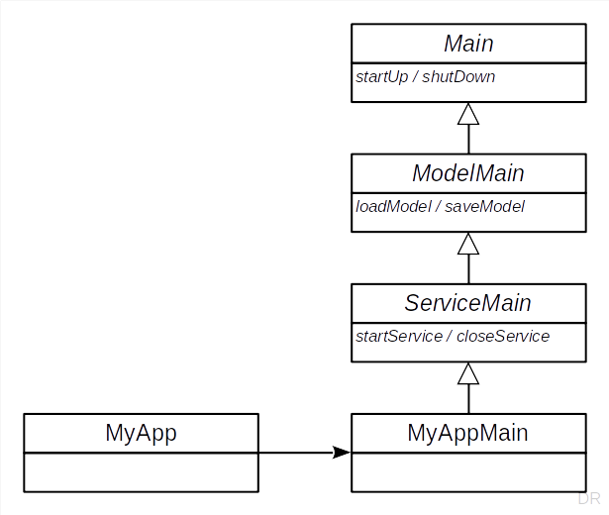
App with Service Example
import { MyAppMain } from "./MyAppMain";
function main(args: string[]) {
let appMain: MyAppMain = new MyAppMain();
appMain.run(args);
}
let args: string[] = process.argv;
args = args.slice(2);
main(args);

Slide 39
Cascading Inheritance Interfaces 1 / 2
export abstract class Main {
public run(args: string[]): void {
this.parseArgs(args);
this.startUp();
this.execute();
this.shutDown();
};
protected parseArgs(args: string[]): void {
// do nothing (expect subclass to override)
}
protected startUp(): void {
// do nothing (expect subclass to override)
}
protected abstract execute(): void;
protected shutDown(): void {
// do nothing (expect subclass to override)
}
}
import { Main } from "./Main";
export abstract class ModelMain extends Main {
protected startUp(): void {
super.startUp();
this.loadModel();
}
protected loadModel(): void {
// do nothing (expect subclass to override)
}
protected shutDown(): void {
this.saveModel();
super.shutDown();
}
protected saveModel(): void {
// do nothing (expect subclass to override)
}
}

Slide 40
Cascading Inheritance Interfaces 2 / 2
import { ModelMain } from "./ModelMain";
export abstract class ServiceMain extends ModelMain {
protected startUp(): void {
super.startUp();
this.startService();
}
protected startService(): void { /* ... */ }
protected execute(): void {
// start main event loop
}
protected shutDown(): void {
this.closeService();
super.shutDown();
}
protected closeService(): void { /* ... */ }
}
import { ServiceMain } from "./ServiceMain";
export class MyAppMain extends ServiceMain {
protected loadModel(): void {
// do something
}
protected startService(): void {
// do something
}
protected saveModel(): void {
// do something
}
protected closeService(): void {
// do something
}
}

Slide 41
Homework

Slide 42
Homework Instructions
Extract AbstractName superclass from StringName and StringArrayName
Identify and implement the narrow (minimal) inheritance interface
Move as much as you sensibly can into the AbstractName class
Adapt your previous work to this homework as you see fit
Commit homework by deadline to homework folder

Slide 43
Summary
What is subtyping?
Liskov substitutability principle
Applied to class hierarchies
Co- and contravariance
Multiple inheritance
Abstract superclass rule
Cascading class hierarchies

Slide 44
Thank you! Any questions?
dirk.riehle@fau.de – https://oss.cs.fau.de
dirk@riehle.org – https://dirkriehle.com – @dirkriehle

Slide 45
Legal Notices
License
Licensed under the CC BY 4.0 International license
Copyright
© 2012, 2018, 2024 Dirk Riehle, some rights reserved

